Slide 1
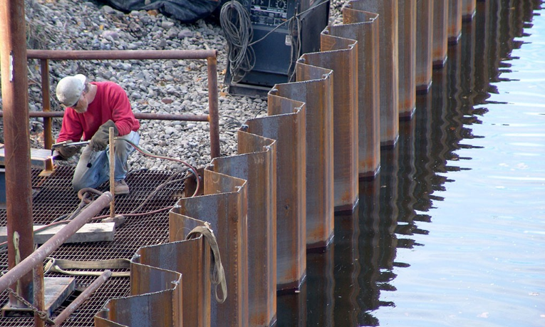
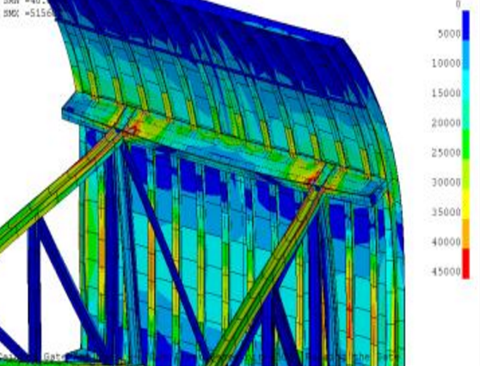
Who am I?
1998, Civil Engineering with honor ------------------------------------------------ [Tehran Polytechnic University, Iran]
2000, Civil Engineering (M.Sc.) [Sharif University of Technology, Iran]
2005, Civil Engineering (M.Sc.) ------------------------------------------------ [The University of Texas at Arlington]
2015, Geosystems Engineering (Ph.D.) [The University of Texas at Austin]
Structural Sheet Pile
Ref: internet
My first academic FE simulation, 1999
Notes:
My first exposure to Ansys -> Soil-structure interaction (ANSYS 5.4)

Slide 2
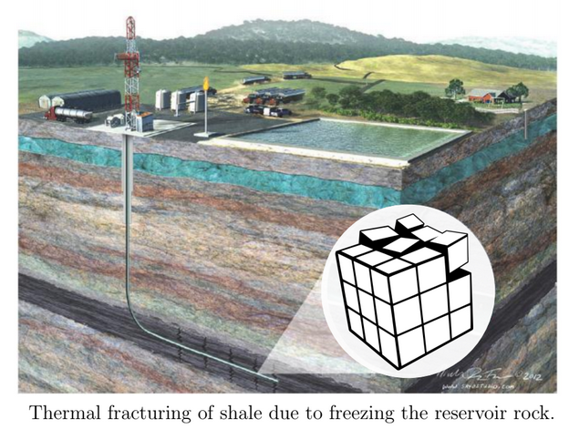
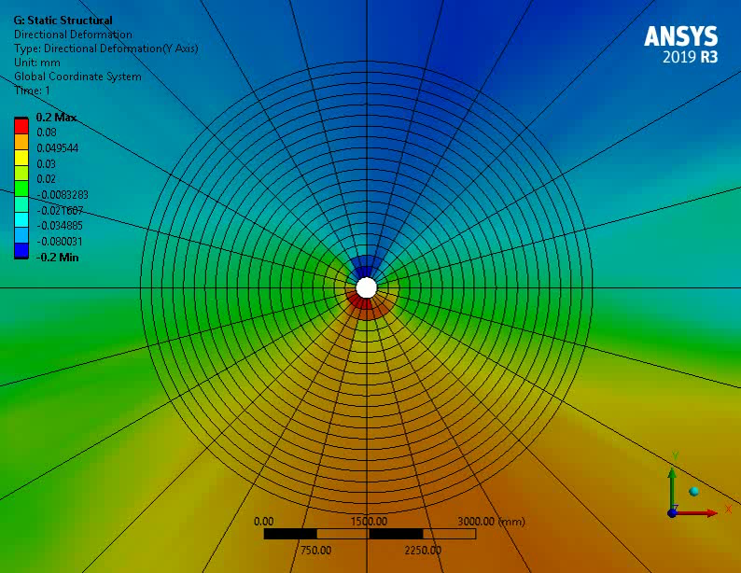
Who am I?
1998, Civil Engineering with honor ------------------------------------------------ [Tehran Polytechnic University, Iran]
2000, Civil Engineering (M.Sc.) [Sharif University of Technology, Iran]
2005, Civil Engineering (M.Sc.) ------------------------------------------------ [The University of Texas at Arlington]
2015, Geosystems Engineering (Ph.D.) [The University of Texas at Austin]
My last academic FE simulation, 2015
Notes:
My first exposure to Ansys -> Soil-structure interaction (ANSYS 5.4)

Slide 3
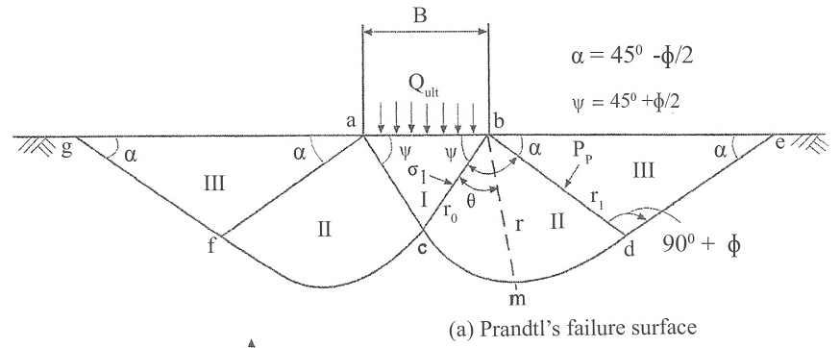
Geomechanics R&D
Prandtl 1920 developed the equations based on his experiment of long hard plate puncher into soft material to compute bearing capacity. This model was later used in many geomechanics applications.
Assumptions:
1)Sublayer material is homogeneous, isotropic, and softer. 2) Material possesses only cohesion and friction
3)Problem is solved in 2D
4)No friction between puncher and rock

Slide 4
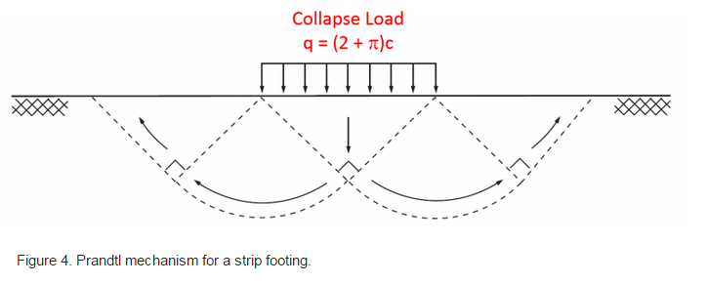
Geomechanics R&D
References:
1. K. Terzaghi and R. B. Peck (1967), Soil Mechanics in Engineering Practice, 2nd Ed. New York, John Wiley and sons.
2. S. W. Sloan and M. F. Randolph (1982), Numerical Prediction of Collapse Loads Using Finite Element Methods, Int. J. Num. & Anal. Methods in Geomech., Vol. 6, 47-76.

Slide 5
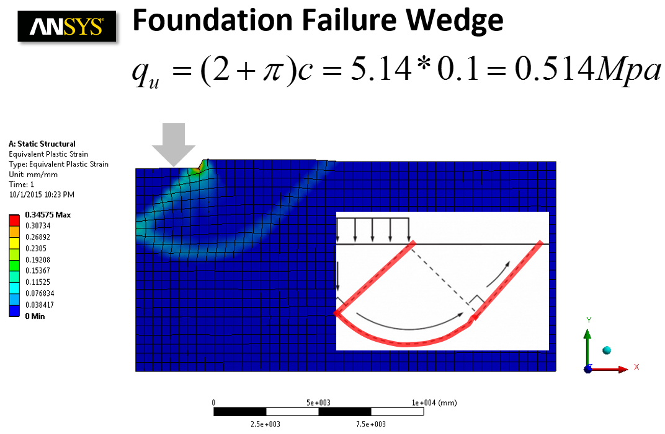
Geomechanics R&D

Slide 6
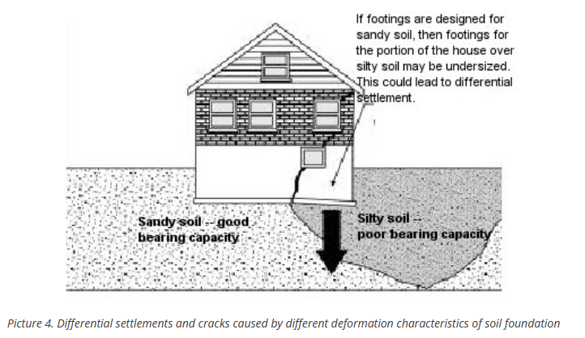
Geomechanics R&D

Slide 7
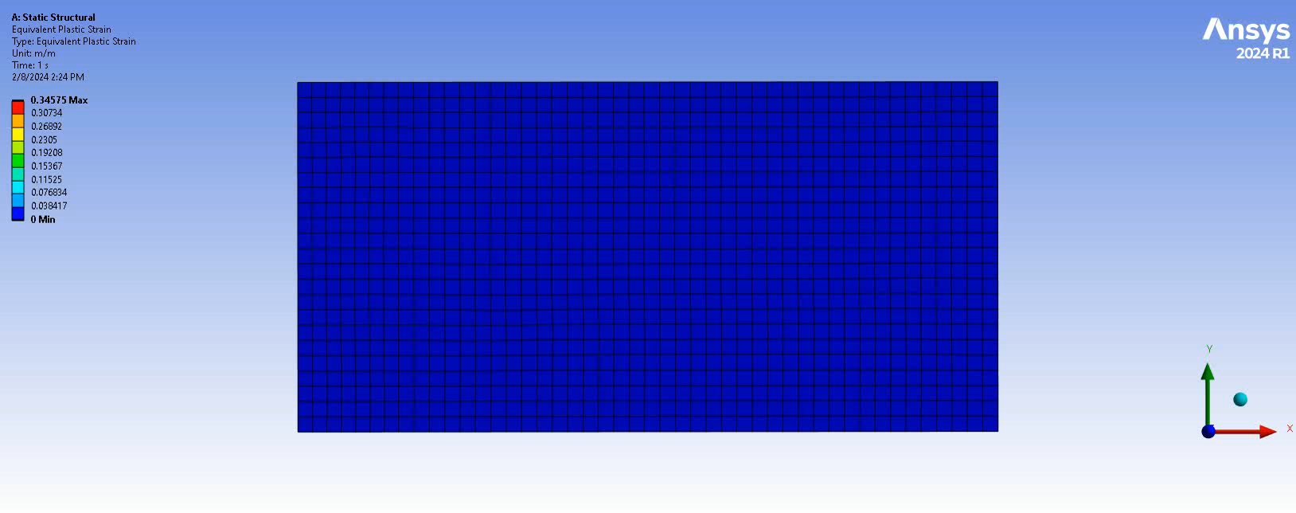
Geomechanics R&D
01 - Foundation_Settlement_10sec.mp4

Slide 8
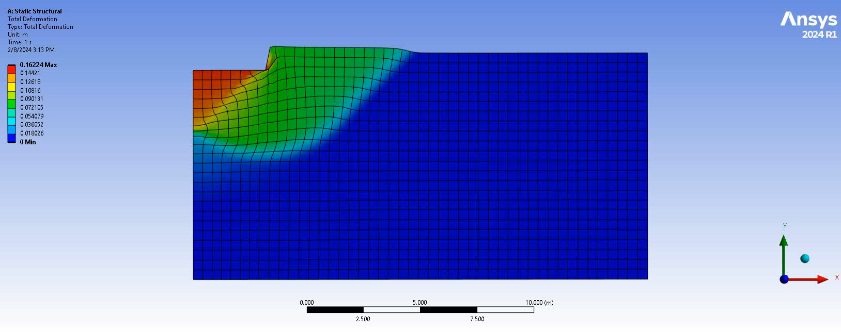
Geomechanics R&D
02 - Foundation_Settlement_4sec_Utotal.mp4

Slide 9
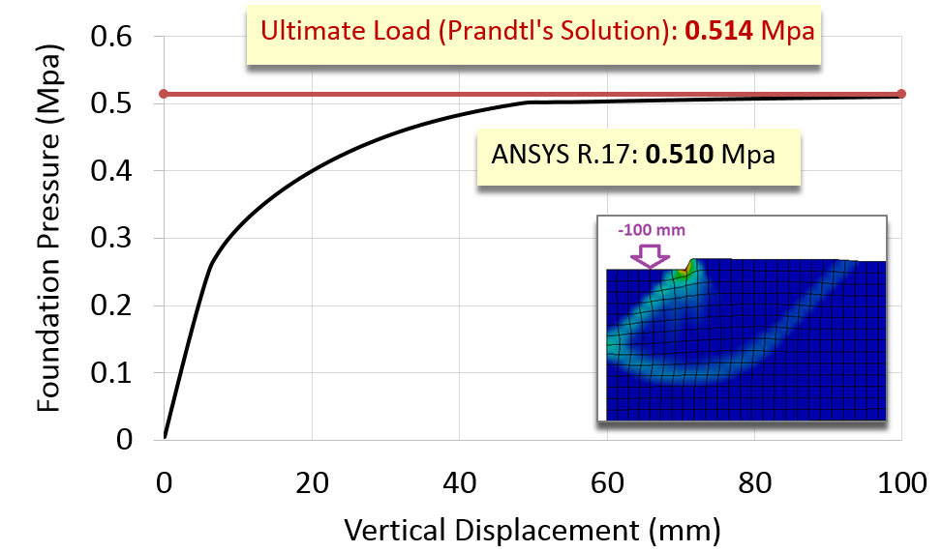
Geomechanics R&D
Error= 0.8% < 3% ☺

Slide 10
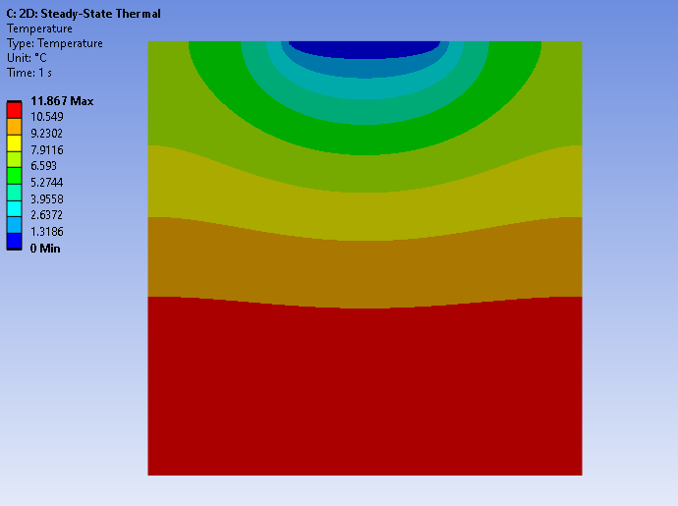
Heat Topology Optimization – 2D

Slide 11
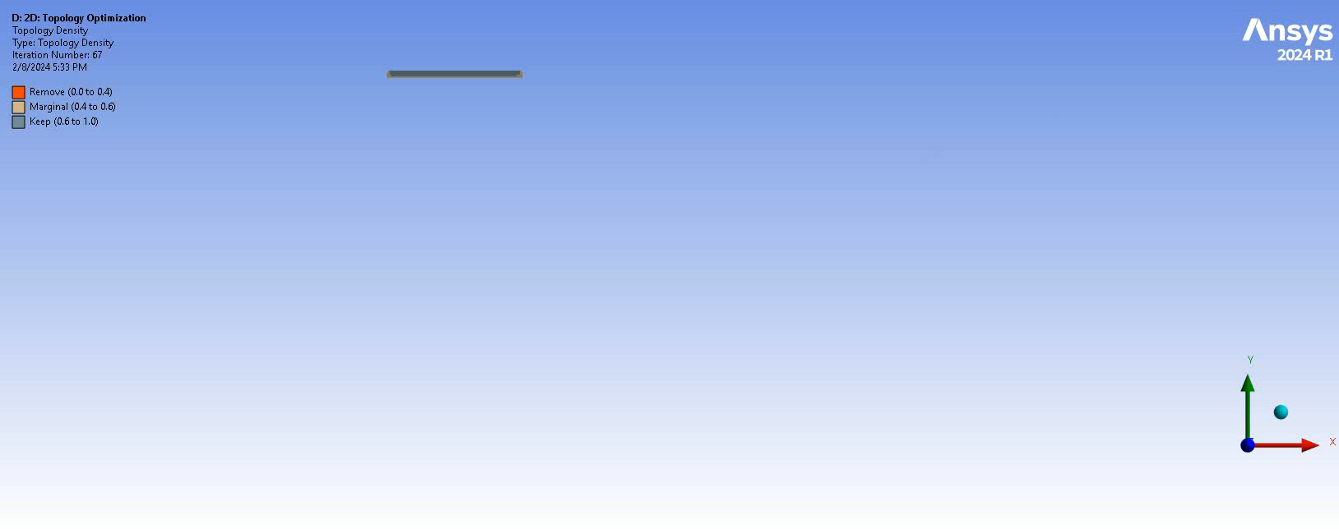
Heat Topology Optimization – 2D
03 - HeatTO2D.mp4

Slide 12
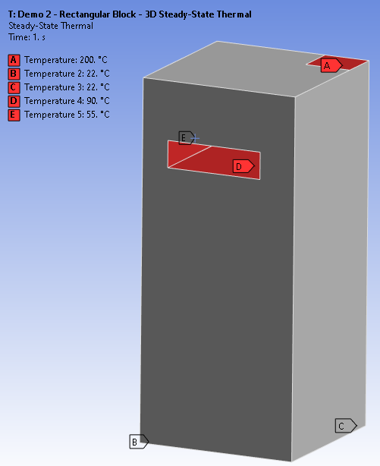
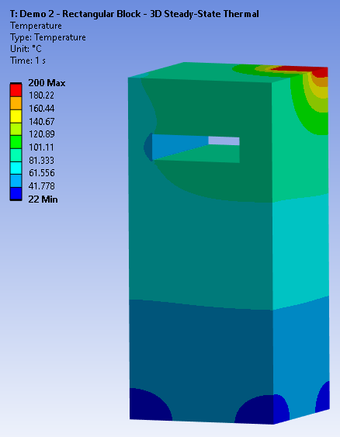
Heat Topology Optimization – Level Set Method 3D

Slide 13
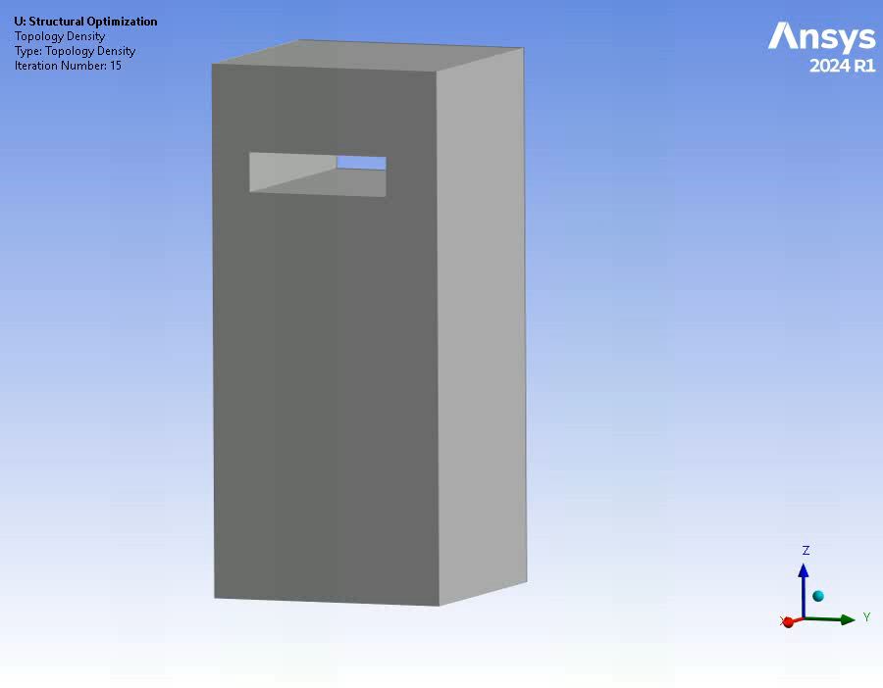
Heat Topology Optimization – Level Set Method 3D
04 - HeatTO3D.mp4

Slide 14
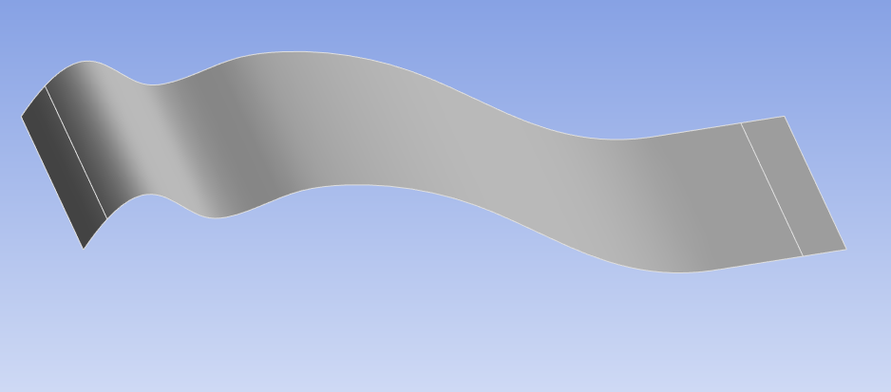
Topography Optimization

Slide 15
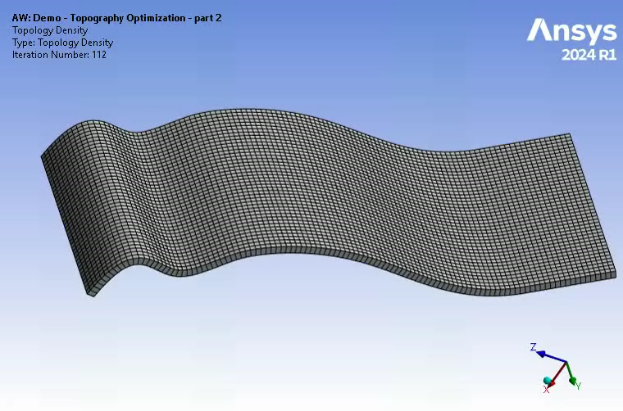
Topography Optimization
05 - Topography_shell_Mode1.mp4

Slide 16
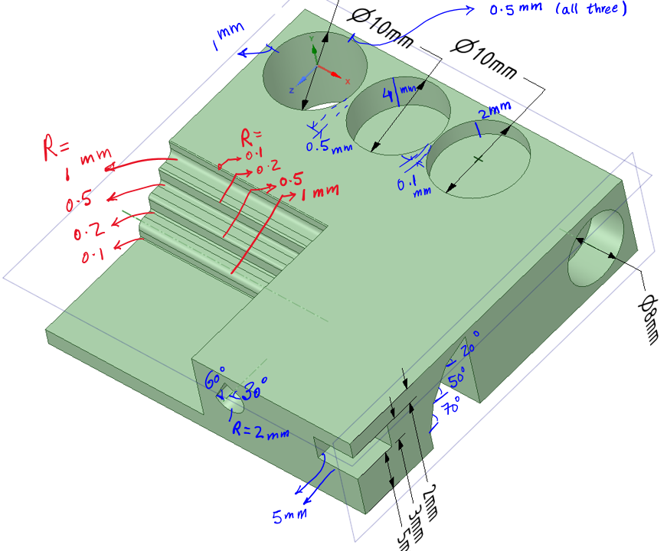
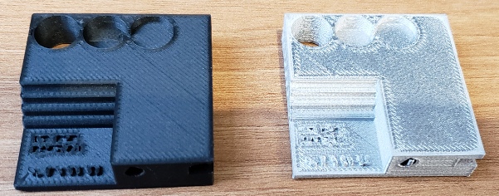
The University of Texas at Austin

Slide 17
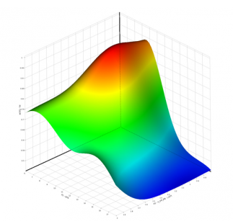
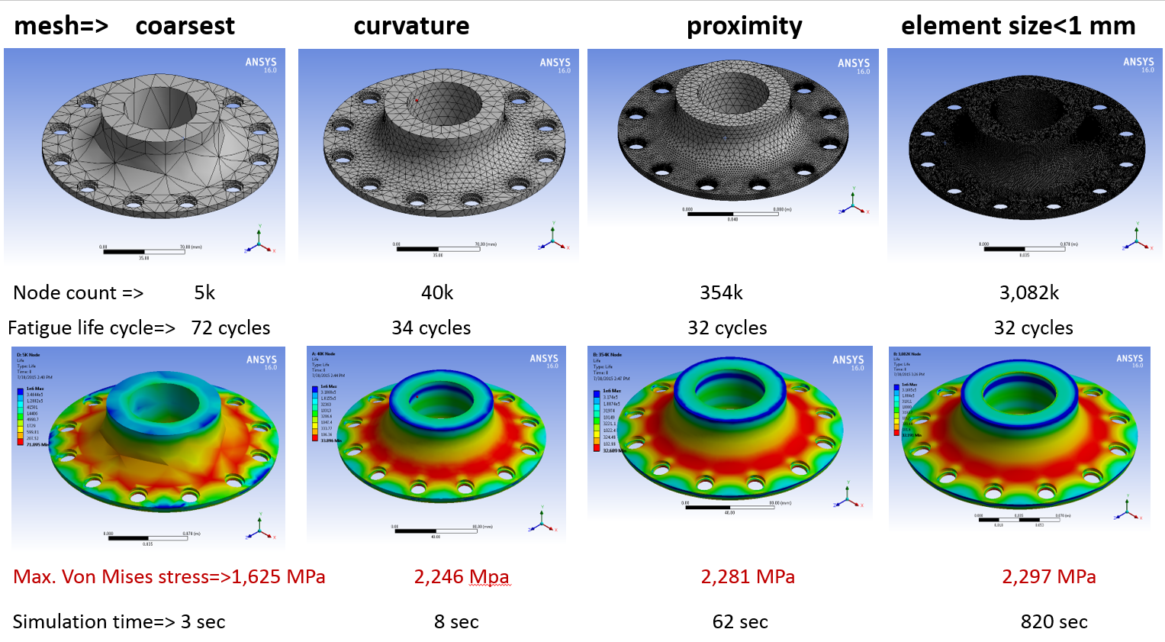
Uncertainty Analysis – Response Surface Analysis

